Slide 1
Redox Reactions
REVISION

Slide 2
Oxidation Reduction
Revision

Slide 3
Definitions
Oxidation is
    addition of
    loss of
    increase in
oxygen
electrons
oxidation number

Slide 4
Reduction is
    loss of oxygen
    gain of electrons
    decrease in oxidation number

Slide 5
More…
An oxidising agent causes oxidation
and is itself reduced.
A reducing agent causes reduction
and is itself oxidised.
What is a redox reaction?

Slide 6
What is oxidised and reduced in each of the following?
Br₂ + 2Fe ²⁺ → 2Br– + 2Fe ³⁺
Cu ²⁺ + Zn → Cu + Zn ²⁺
2Na + Cl₂ → 2NaCl

Slide 7
Oxidation Number Rules
The oxidation number of
    an free Element is
        0

Slide 8
In Compounds
    The oxidation number of
    group One elements is +1
    group Two elements is +2

Slide 9
    The oxidation number of
    an ion is equal to the
        charge on the ion
    halogens is
    -1 (in binary compounds)
    (except ……????)

Slide 10
The oxidation number of
H in a compound
        is +1
      except
      in metal hydrides when it is -1

Slide 11
The oxidation number of
O in a compound is
        -2
      except (x2)
        in peroxides when it is -1 (H₂O₂)
      in OF₂ when it is +2 (why?)

Slide 12
Oxidation numbers
    add up to zero in a compound
    add up to the charge of a complex ion

Slide 13
What is the oxidation number of each element in :-
H₂0
MnO₄¯
I₂
KBrO₃
Na₂S₂O₃
H₂O₂
NaClO

Slide 14
KMnO₄
oxidising agent
purple
read top of meniscus
is reduced from
    Mn (VII) → Mn (II) in presence of H⁺
    purple → colourless
own indicator
(end point = first permanent pink)

Slide 15
KMnO₄
get brown Mn (IV) if H⁺ absent
(which acid MUST be used – why x2)
not primary standard (x2)
standardised by titrating against standard solution of acidified Fe ²⁺

Slide 16
H₂SO₄
added during KMnO₄ titrations to provide H⁺ and ensure the complete reduction of Mn (VII) → Mn (II)
and prevent formation of Mn (IV)
(brown)
added during prep. of Fe (II) solutions to
prevent oxidation of Fe ²⁺ to Fe ³⁺ by oxygen in the air ( why does this matter?)

Slide 17
Na₂S₂O₃
S₂O₃ ²⁻ ion
reducing agent
used in photography
not primary standard – why ?
standardised by titrating against I ₂
starch indicator – when added and why
colour change at end point ?

Slide 18
Iodine I₂
Oxidising agent
NOT a primary standard (X2)
Produced when MnO₄⁻ oxidises I⁻ to I₂
        (known concentration) (in excess)
Starch indicator – when added? why then?
Colour change at end point
Blue/black to colourless

Slide 19
Bleach
sodium hypochlorite Na⁺ClO⁻
bleach diluted x10 with distilled water
not de-ionised water (why? )
ClO⁻ oxidises I⁻ to I₂
Iodine v. thiosulfate
starch indicator as before
NB
remember dilution factor
in calculations

Slide 20
Oxidation
Loss of electrons by a species
Increase in oxygen
Increase in oxidation number

Slide 21
Reduction
Gain of electrons by a species
Decrease in Oxygen
Decrease in Oxidation Number
Increase in Hydrogen

Slide 22
Oxidising Agent
Species which causes oxidation
Species which is reduced
Electron acceptor

Slide 23
Reducing Agent
Species which causes reduction
Species which is oxidised
Electron donor

Slide 24
Remember!
OILRIG
Oxidation is Loss
Reduction is Gain

Slide 25
Oxidation Number
The charge an atom would have in a molecule if electrons were completely transferred
The charge on an atom if electrons are distributed by rules ( L Cert 2002 marking scheme)

Slide 26
Rules for assigning O.N’s
Free elements: O.N of zero
e.g. Na, O₂, Mg, Cl₂ etc
Ions: O.N = charge on ion
e.g. Mn⁺² : O.N = +2
O⁻² : O.N = -2

Slide 27
Rules
O.N of oxygen in compond
- usually -2, but in H₂ O₂ : O.N = -1
O.N of Hydrogen in compond : +1,
except in Metal hydrides
e.g NaH
O.N = -1

Slide 28
Rules
Group 1 metals in componds : O.N = +1
Group 2 metals in componds : O.N = +2
Flourine in compond always -1
Sum of O.N’s of all atoms in a molecule or ion is equal to the charge on the molecule or ion.
e.g. MnO₄⁻
+7 +4(-2) = -1

Slide 29
Question 1
What is O.N of sulphur in
SO₂
SO₄⁻
H₂S

Slide 30
Answer
SO₂
x+2(2) =0
x–4 =0
x =4
=> O.N of S in SO₂ = +2

Slide 31
Answer
(b) SO₄⁻
x+4(-2) = -2
x = -2 + 8
x = +6
  O.N of S in SO₄⁻ = +6

Slide 32
Answer
H₂S (O.N of H with non metal = +1)
2(+1) + x = 0
+2 + x = 0
x = -2
=> O.N of S in HS₂ = -2

Slide 33
Question 2
What is O.N of chlorine in HClO₃ ?

Slide 34
Answer
HClO₃ (Note : sum of O.N’s = 0)
+1 + x + 3(-2) = 0
1 + x - 6 = 0
x - 5 = 0
x = +5
=> O.N of Cl = +5

Slide 35
Question 3
What is O.N of Chromium in
Cr₂O₇⁻² ?

Slide 36
Answer
Cr₂O₇⁻² ( O.N of ion = -2)
2x + 7(-2) = -2
2x – 14 = -2
2x = -2 + 14
2x = +12
x = 6
O.N of Cr in Cr₂O₇⁻² = +6

Slide 37
Balancing Redox Equation
Balance the following equation.
Cr₂O₇⁻² + Fe⁺² + H⁺-> Cr⁺³ + Fe⁺³ +H₂O

Slide 38
Step by Step Guide
Write in the O.N of each element.
Identify species oxidised and reduced.
Balance electron transfer.
Balance the other species.
Check that charges are balanced.

Slide 39
Cr₂O₇⁻² + Fe⁺² + H⁺ -> Fe⁺³ + Cr⁺³ + H₂O
+6-2 +2 +1 +3 +3 +1-2
Fe is oxidised (+2 -> +3)
Cr is reduced (+6 -> +3)

Slide 40
Cr⁺⁶ + 3e -> Cr⁺³ (reduced)
Fe⁺² -> Fe⁺³ + 1e (oxidised)
½ equation Cr⁺⁶ + 3e -> Cr⁺³
½ equation 3Fe⁺² -> 3Fe⁺³ + 3e

Slide 41
½ equation :Cr⁺⁶ + 3e -> Cr⁺³
½ equation :3Fe⁺² -> 3Fe⁺³ + 3e
Add Cr⁺⁶ + 3Fe⁺² -> Cr⁺³ + 3Fe⁺³
Multiply by 2
2Cr⁺⁶ + 6Fe⁺² -> 2Cr⁺³ + 6Fe⁺³
Rewrite eqn.
Cr₂O₇⁻² + 6Fe⁺² + H⁺ ->
6Fe⁺³ +2Cr⁺³ + H₂O

Slide 42
Now balance the other species
Cr₂O₇⁻² + 6Fe⁺² + 14H⁺ -> 6Fe⁺³ + 2Cr⁺³ + 7H₂O
Finally,
Check that the charges balance.
L.H.S -2 +12 + 14 = +24
R.H.S +18 +6 = +24
Charges balance
Equation is balanced

Slide 43
More Redox Reactions
Hydrogen Displacement Reactions
Most metals displace Hydrogen from acids to form Hydroden gas.
e.g. Mg + 2HCl -> MgCl₂ + H₂
0 +1 -1 +2 -1 0
Mg -> Mg⁺² + 2e
2H⁺ + 2e -> H₂
.: oxidation / reduction reaction

Slide 44
2. Metal Displacement Reactions
Zn + CuSO₄ -> ZnSO₄ + Cu
0 +2+6-2 +2+6-2 0
Zn -> Zn⁺² +2e
Cu⁺² + 2e -> Cu
Zn is a better reducing agent than Cu.
Zn displaces Cu ions from solution.

Slide 45
3. Halogen Displacement Reactions
F₂ > Cl₂ > Br₂ > I₂
Most least
oxidising oxidising
e.g. Cl₂ + 2KBr -> 2KCl +Br₂
0 +1-1 +1-1 0
Chlorine is more strongly oxidising than Bromine, so Bromide is oxidised to Bromine and Chlorine is reduced to Chloride.

Slide 46
Titration Colour Changes for Redox Reactions
1. Potassium Permanganate vs Ammonium Iron(11) Sulphate
2. Iodine vs Thiosulphate

Slide 47
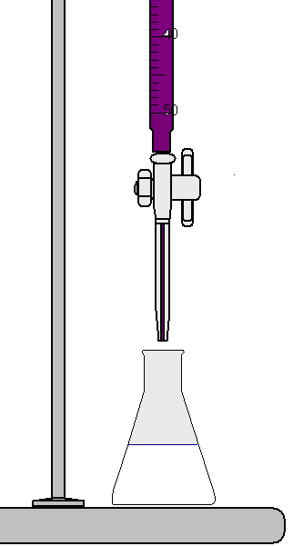
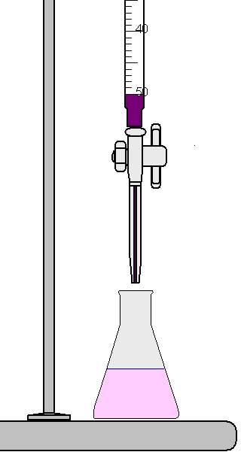
Redox Titrations
Potassium Permanganate v Ammonium Iron (II) Sulphate
KMnO₄
Indicator:- Potassium Permanganate
Persisting Pale Pink
(NH₄)₂SO₄.Fe(ll)SO₄

Slide 48




Redox Titrations
Iodine v Thiosulphate
Indicator:- Starch
Starch
I₂ Soln.
Brown
I₂ Soln.
Pale Yellow
Blue Black
End Point
Colourless

Slide 49
Review Quiz
1. Balance the following equations
a) Cr₂O₇²⁻_{(aq)} + S₂O₃²⁻_{(aq)} ⎯→ Cr ³⁺_{(aq)} + S₂O₆²⁻_{(aq)}
b) Mn³⁺ _{(aq)} ⎯→ MnO_{2 (s)} + Mn²⁺ _{aq)}
c) C₃H_{8(aq)} + O_{2(aq)} ⎯→ CO_{2(aq)} + H₂O_{(l)}
2. For the above equations, state what is the reducing agent and what is the oxidizing agent.

Slide 50
3. Give the oxidation states of the following substances
a) Mn³⁺ b) MnO₂
c) C₃H₈ d) O₂
e) CO₂ f) H₂O_{(l)}
g) MnO₄⁻ h) S₂O₃²⁻
i) Mn ²⁺ j) S₂O₆²⁻_{(aq)}

Slide 51
4. Write the 1/2 equations for redox reactions inside a lead acid battery. Then state which reaction occurs at the cathode and anode.
5. Using oxidation states work out what is being oxidized and what is being reduced
a) 6Na _{(s)}+ N₂ _{(g)} ⎯→ 2Na₃N _{(s)}
b) Mg _{(s)}+ Cl₂ _{(g)} ⎯→ MgCl₂ _{(s)}
c) 4Fe _{(s)}+ 3O₂ _{(g)} ⎯→ 2Fe₂O₃ _{(s)}
d) Ca _{(s)}+ C _{(s)} ⎯→ CaC₂ _{(s)}
e) MnO₄⁻_{(aq)} + S₂O₃²⁻_{(aq)} ⎯→ Mn ²⁺_{(aq)} + S₂O₆²⁻_{(aq)}
f) VO₂⁺_{(aq)} + Zn _{(s)} ⎯→ VO ²⁺_{(aq)} + Zn²⁺_{(aq)}

